Slide 1
The Synthetic CT (sCT) Problem
Yorick Chern

Slide 2
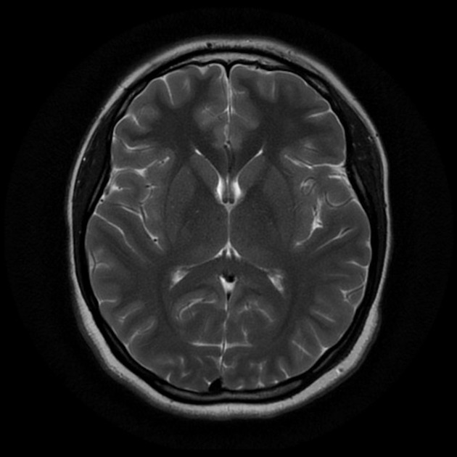
Magnetic Resonance Imaging (MRI)

Slide 3
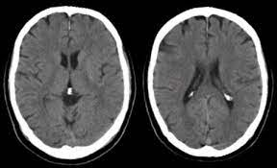
Computerized Tomography (CT)

Slide 4
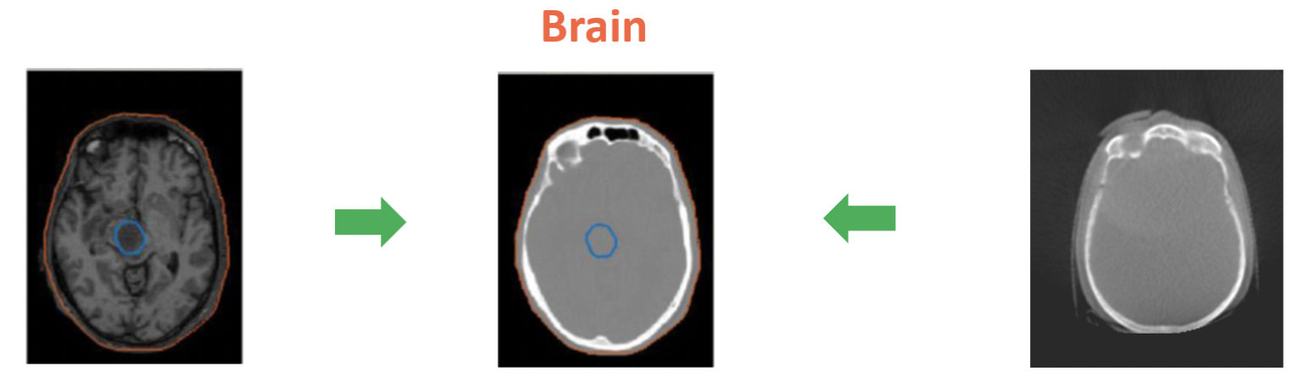
The sCT Problem
MRI’s usually cross-registered with CT scans
Increased workload, extra radiation to patients (unhealthy for younger patients), more $$$, longer wait times for patients, etc.
Goal: synthesize CT scans with just one MRI as the input.

Slide 5
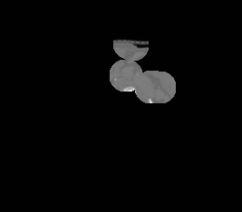
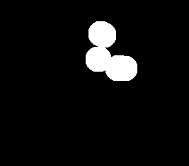
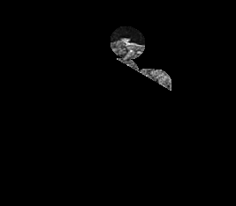
MRI vs CT - Dataset Provided
CT
MRI
Mask

Slide 6
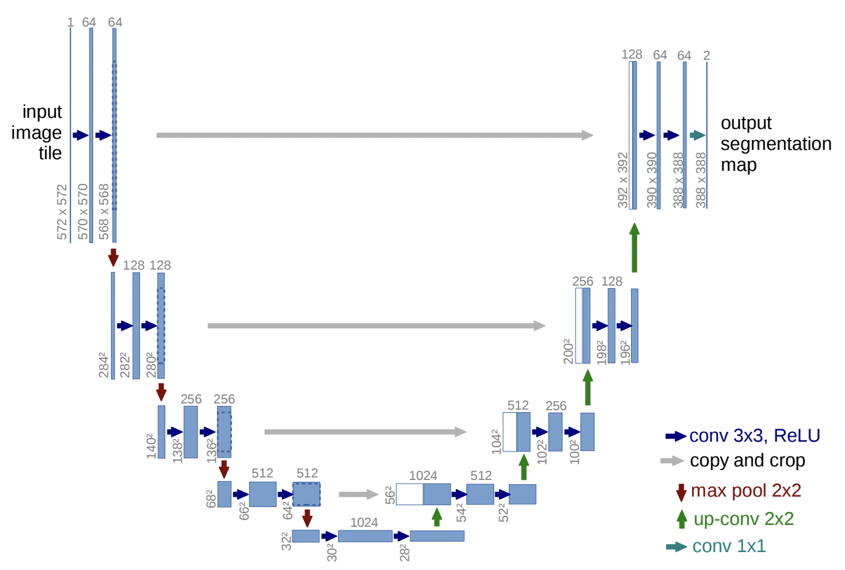
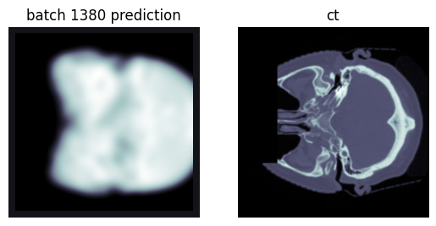
Attempt #1: U-Net (Ronneberger et al.)
Naive U-Net image generation
Problem: the mean squared error loss function generates blurry images

Slide 7
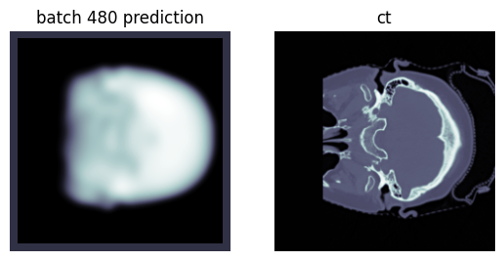
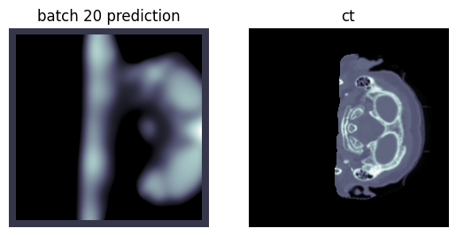
Attempt #1: U-Net

Slide 8
Attempt #2: pix2pix GAN (Isola et al.)
Image-to-Image Translation with Conditional Adversarial Networks
Developed by Dr. Efros and his students from BAIR!
Works very well with tasks that have highly similar visual contents between the inputs and the outputs
MRI and CT scans of the same organ ⇒ similar visual content!
Generator network: 54.414 million parameters
Discriminator network: 2.769 million parameters
Trained on one GPU on Colab (3 hours)
200 epochs
Training size: 1,000 MRI’s

Slide 9
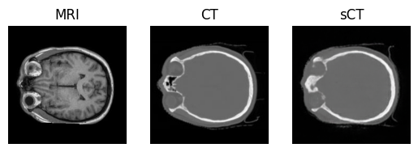
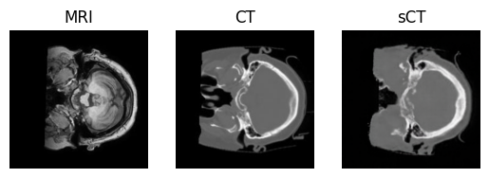
Attempt #2: pix2pix GAN Results

Slide 10
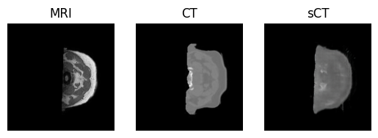
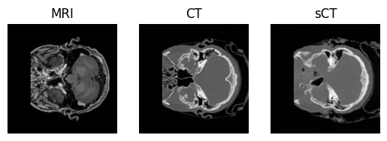
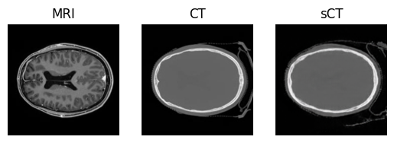

Slide 11
Conclusion
pix2pix GAN works really well!
High potential: Increasing training size + number of epochs likely will produce even better images
Concerns
Pathology preservation: pathology is not lost in translation (ex: a fracture in the skull in the MRI is also visible in the sCT)
Very high stakes: this application is used to facilitate cancer treatments, and a mistake by the model can cause irreversible consequences
Future attempts
Image-to-image diffusion model
More training on the pix2pix GAN

Slide 12
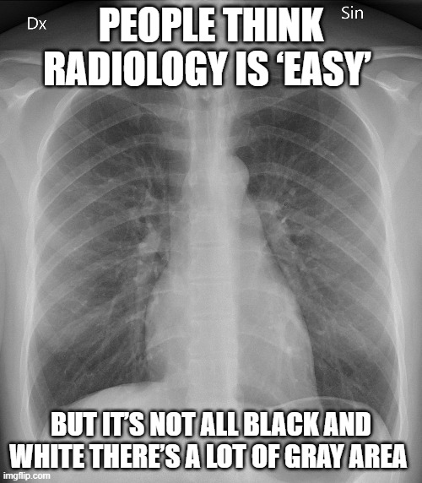
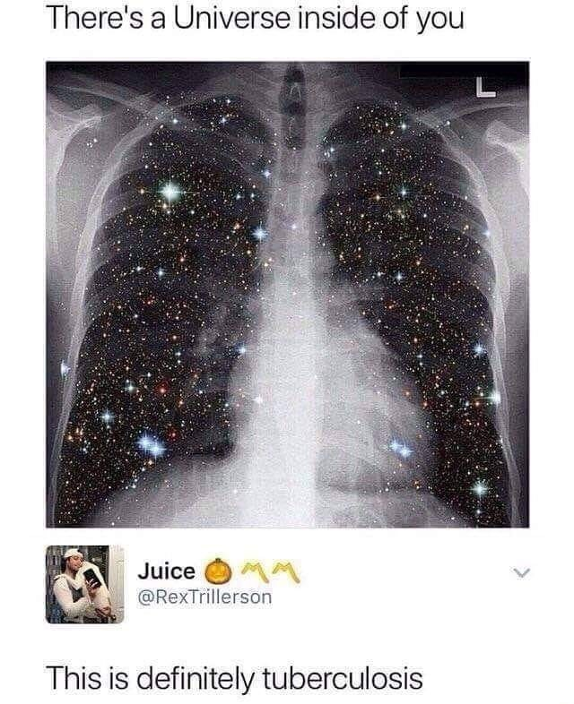
Thank you for listening!

